Slide 1
Database Application Development Methodology© - an Example
Leo Mark & Rocky Dunlap
College of Computing
Georgia Tech
© Copyright: Leo Mark and Rocky Dunlap

Slide 2
Assumptions
Business process is well-designed
Documents are known
Tasks are known
System boundary is known
One database schema unifying all views can be designed
difficult: interests, goals, power, politics
problems with the methodology?
problems with the organization?
or-ga-ni-za-tion: “an entity created to pursue a shared set of goals”

Slide 3
The Software Process
Business process (re-)design
Analysis
Specification
Design
Implementation
Testing
Operation
Maintenance
Unique for Database Methodology
Management

Slide 4
Overview of the Methodology - data first!!
Information
Flow
Diagram
2b
Tasks
Abstract
Code
w/SQL
SQL
4b
PHP Code
w/SQL
1
2a
ER
Diagram
3a
Relational
Schema
4a
MySQL
Relational
Platform
1
Analysis
Specification
Design
Implementation
2
3
4

Slide 5
Example Project Description
The project description represents the customer:
Business process
Documents
Tasks
System boundary

Slide 6
GTOnline is a simple social networking application with a set of basic features similar to those found on sites like Facebook and LinkedIn. GTOnline users maintain a basic profile including their name, birth date, hometown, current city, schools they have attended, and places of employment. Users can connect to other users by sending friend requests. If a request is accepted, then a friendship link is established between the two users. In addition to maintaining basic profile information, users can let their friends know what they are currently doing by writing status updates. Users can also comment on their friends’ status updates as well as their own status updates. The GTOnline application also supports administrative users who maintain the list of schools and places of employment.

Slide 7


GTOnline is a simple social networking application with a set of basic features similar to those found on sites like Facebook and LinkedIn. GTOnline users maintain a basic profile including their name, birth date, hometown, current city, schools they have attended, and places of employment. Users can connect to other users by sending friend requests. If a request is accepted, then a friendship link is established between the two users. In addition to maintaining basic profile information, users can let their friends know what they are currently doing by writing status updates. Users can also comment on their friends’ status updates as well as their own status updates. The GTOnline application also supports administrative users who maintain the list of schools and places of employment.
Read the full example project description!
Screen shots and small requirement snippets are shown on the following slides. These are not sufficient to develop the application in this example.

Slide 11
[Requirement]: ….. Logging In to GTOnline via the login screen. All users are uniquely identified by his or her Email Address. Providing a valid Email Address and Password combination will log the user into the system. Providing invalid login credentials should display an error message and return the user to the login screen.
[Requirement]: ….. Users who are new to GTOnline must register first. A Register button is provided directly on the login page. Clicking this button displays the new user registration form.
After the user clicks Register, the system should verify that all fields are filled in, that the Email Address has not already been registered, and that the Password and Confirm Password fields are equal.
[Requirement]: ….. All GTOnline users (except administrative users) have a User Profiles containing basic information about them. After a new user registers with GTOnline, they should be taken immediately to the Edit Profile screen. The basic profile properties include the user’s Sex, Birthdate, Current City, Hometown, and any number of Interests.
These snippets of task requirements are taken from a comprehensive project description and are just part of what is used to design the IFD Diagram.

Slide 12
[Requirement]: ….. Social networks are all about making connections. GTOnline allows users to search for friends and connect to them. There are several steps involved in making a connection with a new friend on GTOnline:
The user searches for a friend based on several profile criteria including Name, Email Address, and Hometown.
Then, the user submits a friend request to another user with whom they wish to connect.
Finally, the other user receives the friend request and accepts it or rejects it.
[Requirement]: ….. The profile also contains professional information. The user will select his or her Employer from the list and then provide a Job Title.
[Requirement]: ….. There are a number of links on the View Profile screen:
Clicking View Friends shows the list of friends for this user.
Clicking Log Out signs the user out of the system and shows the login screen.
In addition, the currently logged in user can:
Clicking View Pending Requests to see the list of friend requests that have not yet been accepted or rejected
Clicking Edit Profile shows the Edit Profile screen allowing the user to make changes to his or her own profile.
[Requirement]: ….. The profile also contains information about the user’s education. The set of available Schools and their Types is maintained by the GTOnline. A user can have any number of schools associated with his or her profile and can also provide a Graduation Date for each school.

Slide 13
Analysis – Information Flow Diagram
D2
D3
D4
information flow; not control flow
never connect two documents
never connect two tasks
D1
T1
Database
T2
T3
T4
D6
D5
task
name
document
name
information
flow
system boundary

Slide 14
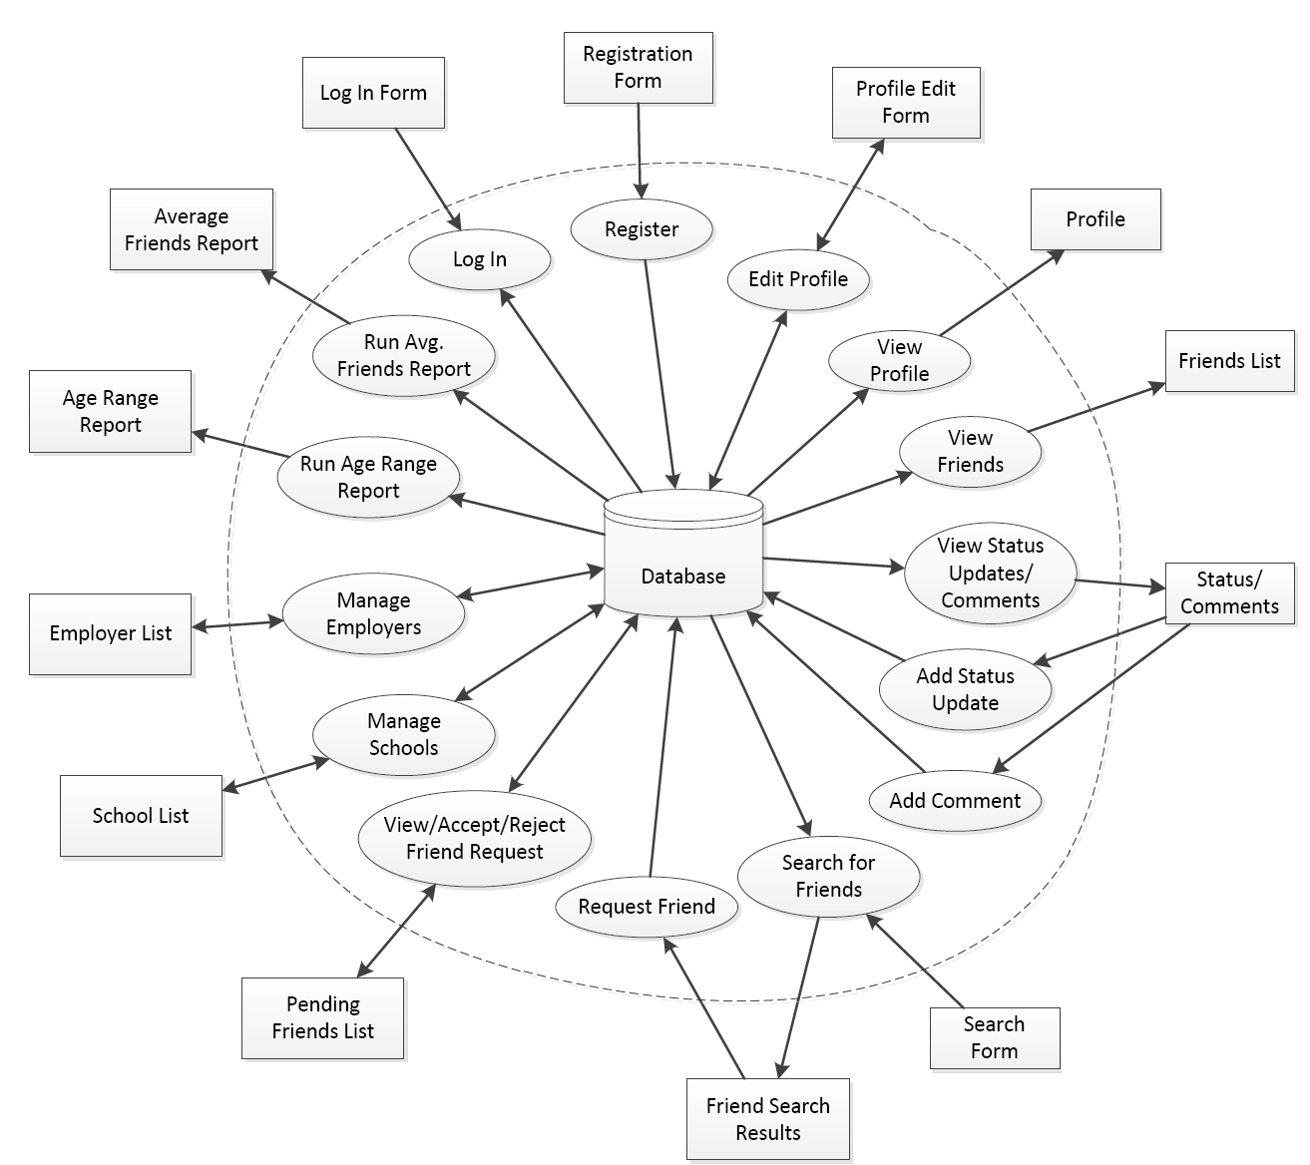
IFD
Use document and task names from the project description in the IFD!
Friend
Search and
Results
Friend
request

Slide 15
D1
D2
D3
?
T1
?
T2
What goes into the database?
What comes out of the database?
Everything in the database must come from somewhere
Everything on the input documents must go somewhere
Everything in the database must be used for something
Everything on the output documents must come from somewhere

Slide 16
Specification
EER Diagram
Data Formats
Constraints
Task Decomposition
Learn about the Entity Relationship Model

Slide 17
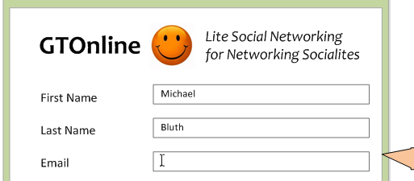
[Requirement]: ….. All users are uniquely identified by his or her Email Address. Providing a valid Email Address and Password combination will log the user into the system …..
Email
Password
FirstName
User
Name
LastName
[Question]: Should Name be a composite attribute? Well, you decide, sort of …..
Name
These snippets of task requirements are taken from a comprehensive project description and are just part of what is used to design the ER Diagram.

Slide 18
Interests
Sex
Birthdate
RegularUser
CurrentCity
HomeTown
Use attribute names from the documents in the EER Diagram!

Slide 19
[Requirements]: ….. All GTOnline users (except administrative users) have a profile containing basic information about them. …..
Email
Password
FirstName
User
Name
Interests
LastName
Sex
⊂
d
⊂
Birthdate
RegularUser
AdminUser
LastLogin
CurrentCity
HomeTown
[Requirements]: ….. Administrative users have some of the same information as regular users (Email Address, Password, First Name, and Last Name) ….., but do not have a full profile and cannot request friends, etc. A user must be either an administrator or a regular user, but never both. GTOnline also tracks the last date and time that an admin user logged in to the system …..

Slide 20
[Requirements]: … A list of Schools, from which the user can select, is maintained in the system. Assume that all School Names will be unique. A user can have any number of schools associated with him or her and can provide a Graduation Date for each school. ….. It is possible that the same school will appear multiple times with different graduation dates.
RegularUser
N
YearGraduated
M
School
SchoolName

Slide 21
RegularUser
N
[Requirements]: ….. Each school must have a School Type. There are four possible types: College/University, High School, Middle School, and Elementary School. ….. It should be possible for the database administrator to add new school types from behind the scenes.
YearGraduated
M
School
N
SchoolName
M
SchoolType
TypeName

Slide 22
RegularUser
N
JobTitle
M
Employer
EmployerName
[Requirements]: ….. Administrators are responsible for managing the list of Employers. Assume that all Employers have a unique Name.
[Requirements]: ….. The Job Title field is not managed by the administrator and can be any value provided by the user. A profile can contain multiple Employers and the same Employer may even appear multiple times as long as the Job Title is different in each case.

Slide 23
RegularUser
1
1
[Requirements]: ….. friendship is not always reciprocal ….. just because Emily is friends with Sarah, this does not imply that Sarah is friends with Emily. …..
accept
request
N
N
….. the DateConnected field is set when the friend request is accepted, not when the request is originally sent.
Relationship
Friendship
DateConnected

Slide 24
EER Diagram
Email
Password
FirstName
User
Name
Interests
LastName
Sex
⊂
d
⊂
Birthdate
RegularUser
AdminUser
LastLogin
CurrentCity
N
N
HomeTown
1
1
YearGraduated
JobTitle
accept
M
M
School
Employer
request
SchoolName
N
N
EmployerName
N
Relationship
Friendship
M
DateConnected
SchoolType
TypeName

Slide 25
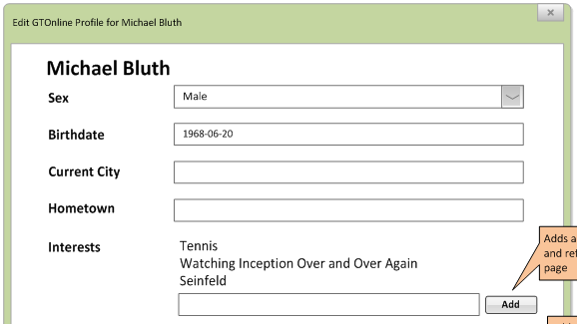
Data Formats
- beg, steal, borrow
Email
Password
FirstName
User
Name
Interests
LastName
Sex
⊂
d
Birthdate
RegularUser
User:
Email: max 36 chars. Example: leomark@cc.gt.edu
Password: max 20 chars. Example: qwerty
Name: FirstName: max 25 chars; Last: max 40 chars
Addresses (when needed) are very very difficult. E.g., look at the 208 page guideline at http://pe.usps.com/cpim/ftp/pubs/pub28/pub28.pdf
RegularUser:
Birthdate: Date: 'YYYY-MM-DD'
Sex: {M, F}
CurrentCity, HomeTown: max 20 chars, each
Interests: multi-value with 16 chars, each
CurrentCity
HomeTown

Slide 26
Constraints
Examples:
DateConnected is NULL until request is accepted.
Cannot be Friend with yourself.
Can only comment on Status of Friends.
Ignore:
Data formatting constraints
Constraints that can be expressed in the EER Diagram

